Slide 1
Chapter 2 Basic Structures: Sets, Functions, Sequences, Sums, and Matrices
Section 2.4 : Sequences and Summations

Slide 2
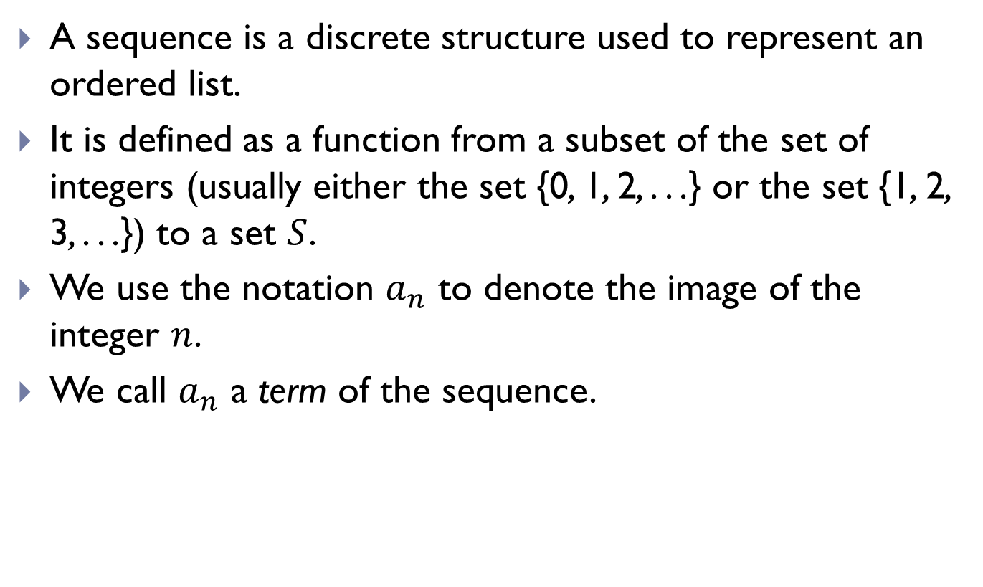
Sequences
A sequence is a discrete structure used to represent an ordered list.
It is defined as a function from a subset of the set of integers (usually either the set {0, 1, 2, . . .} or the set {1, 2, 3, . . .}) to a set $S$.
We use the notation $a_{n}$ to denote the image of the integer $n$.
We call $a_{n}$ a term of the sequence.

Slide 3
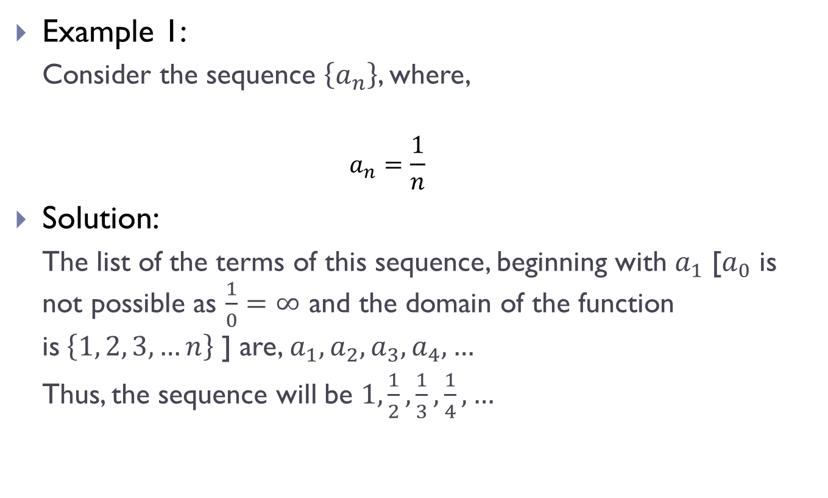
Sequences (Contd.)
Example 1:
Consider the sequence $\left\{a_{n}\right\}$, where,
$$a_{n}=\frac{1}{n}$$
Solution:
The list of the terms of this sequence, beginning with $a_{1}$ [$a_{0}$ is not possible as $\frac{1}{0}=∞$ and the domain of the function is$\left\{1, 2, 3, …n\right\}$ ] are, $a_{1}, a_{2},a_{3},a_{4},…$
Thus, the sequence will be $1,\frac{1}{2},\frac{1}{3},\frac{1}{4},…$

Slide 4
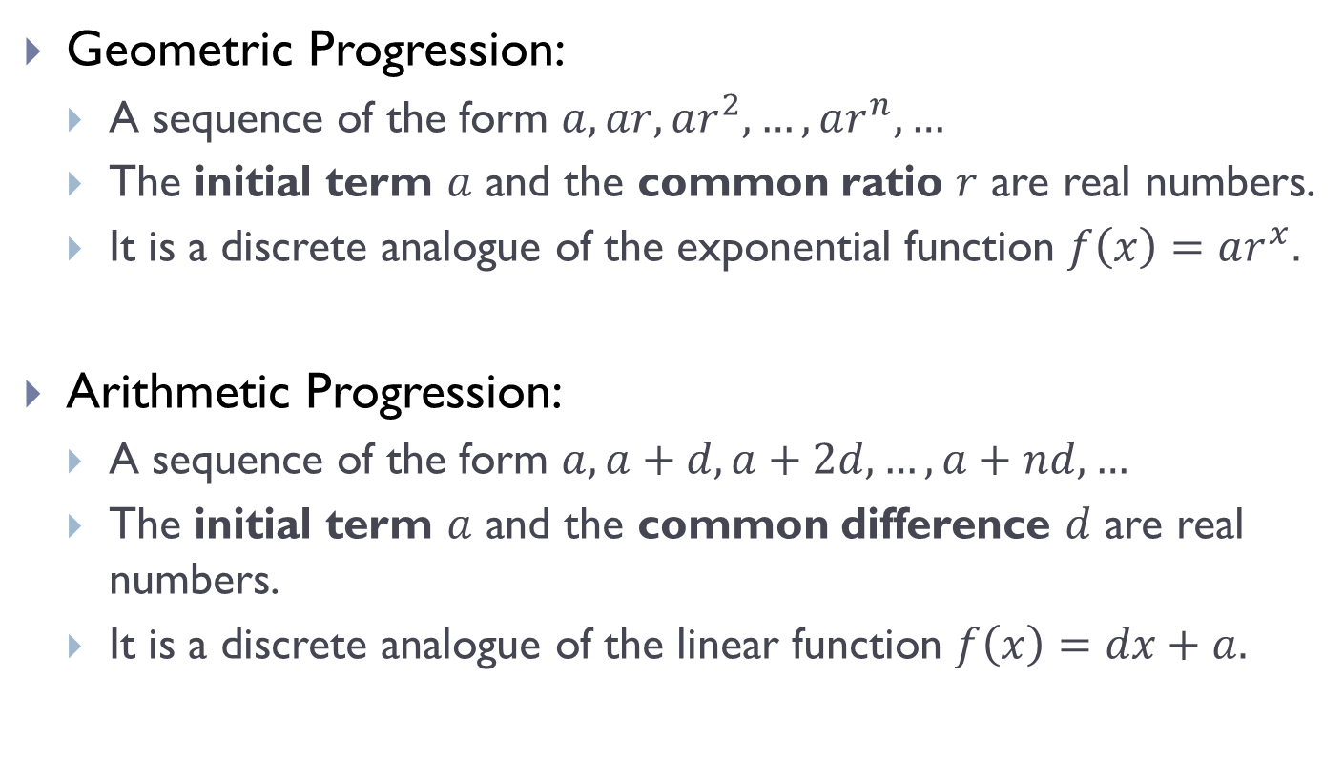
Progressions
Geometric Progression:
A sequence of the form $a, ar, ar^{2}, …, ar^{n}, …$
The initial term $a$ and the common ratio $r$ are real numbers.
It is a discrete analogue of the exponential function $f\left(x\right)=ar^{x}.$
Arithmetic Progression:
A sequence of the form $a, a+d, a+2d, …, a+nd, …$
The initial term $a$ and the common difference $d$ are real numbers.
It is a discrete analogue of the linear function $f\left(x\right)=dx+a.$

Slide 5
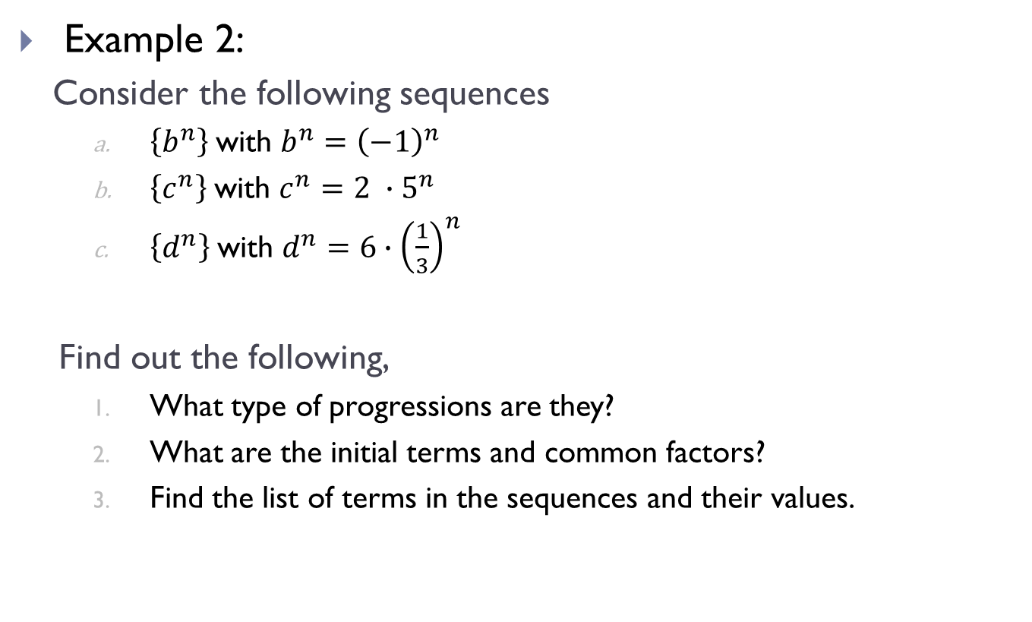
Progressions (Contd.)
Example 2:
Consider the following sequences
$\left\{b^{n}\right\}$with $b^{n}={\left(−1\right)}^{n}$
$\left\{c^{n}\right\}$with $c^{n}={2 ∙5}^{n}$
$\left\{d^{n}\right\}$with $d^{n}={6∙\left(\frac{1}{3}\right)}^{n}$
Find out the following,
What type of progressions are they?
What are the initial terms and common factors?
Find the list of terms in the sequences and their values.

Slide 6

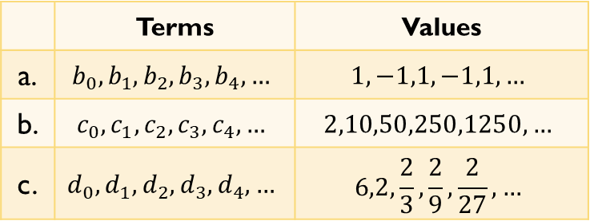
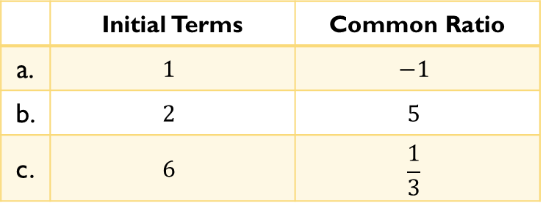
Progressions (Contd.)
Solution:
The progressions in $a, b, c$ are all geometric progressions.
The initial terms and the common ratios are listed below,
The list of terms and their values are listed below,
 | Initial Terms | Common Ratio
a. | $$1$$ | $$−1$$
b. | $$2$$ | $$5$$
c. | $$6$$ | $$\frac{1}{3}$$
 | Terms | Values
a. | $$b_{0},b_{1},b_{2},b_{3},b_{4},…$$ | $$1,−1,1,−1,1,…$$
b. | $$c_{0},c_{1},c_{2},c_{3},c_{4},…$$ | $$2,10,50,250,1250,…$$
c. | $$d_{0},d_{1},d_{2},d_{3},d_{4},…$$ | $$6,2,\frac{2}{3},\frac{2}{9},\frac{2}{27}, …$$

Slide 7
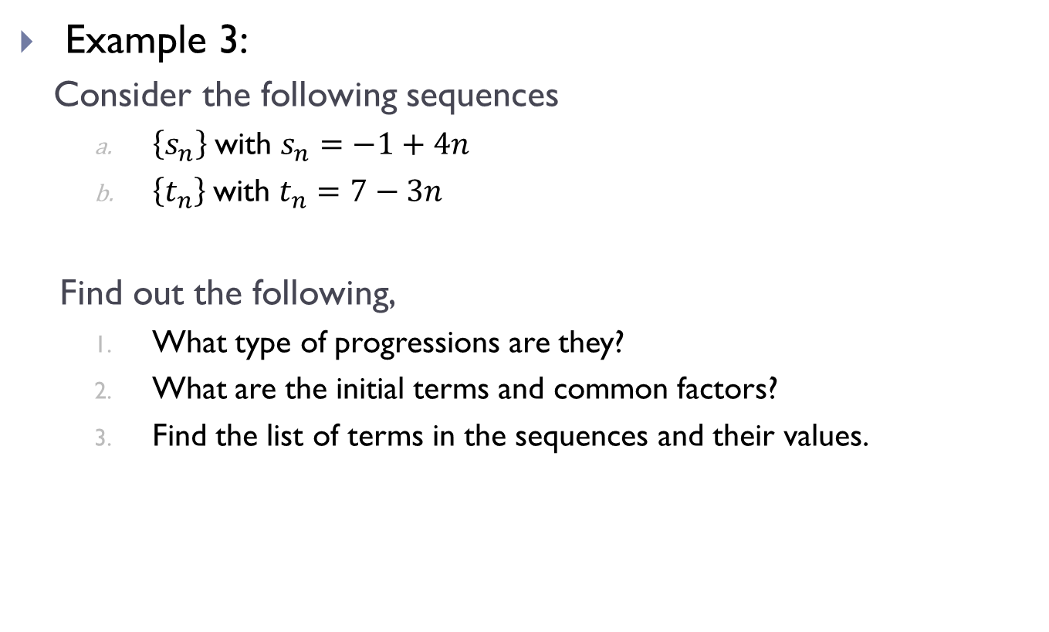
Progressions (Contd.)
Example 3:
Consider the following sequences
$\left\{s_{n}\right\}$with $s_{n}=−1+4n$
$\left\{t_{n}\right\}$with $t_{n}=7−3n$
Find out the following,
What type of progressions are they?
What are the initial terms and common factors?
Find the list of terms in the sequences and their values.

Slide 8
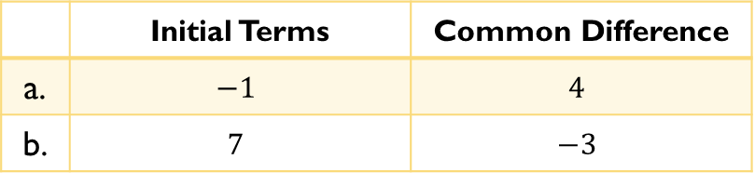
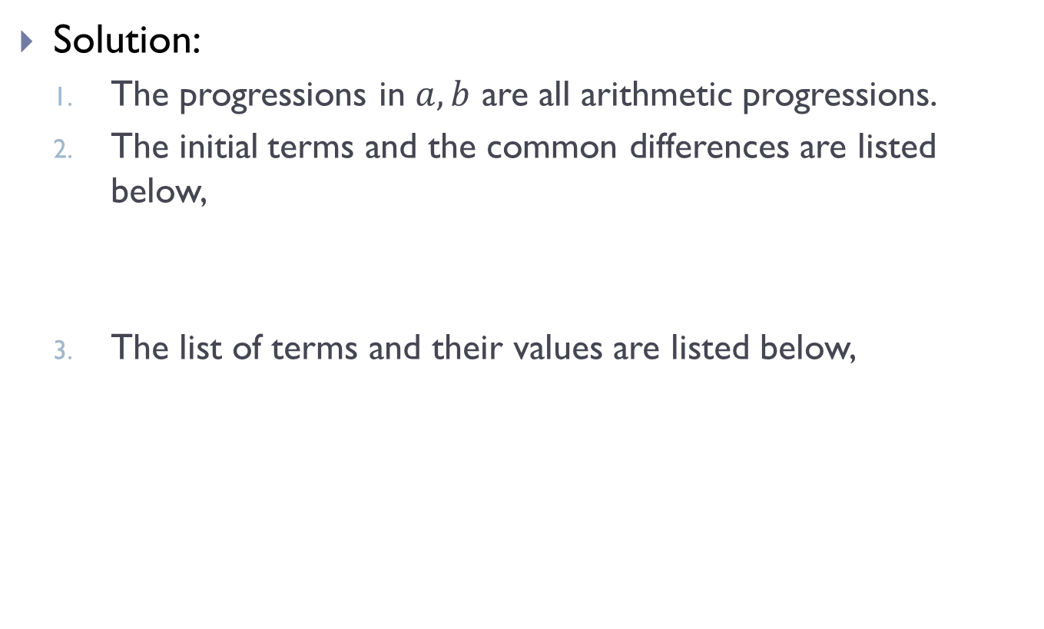
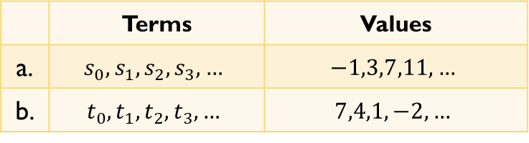
Progressions (Contd.)
Solution:
The progressions in $a, b$ are all arithmetic progressions.
The initial terms and the common differences are listed below,
The list of terms and their values are listed below,
 | Initial Terms | Common Difference
a. | $$−1$$ | $$4$$
b. | $$7$$ | $$−3$$
 | Terms | Values
a. | $$s_{0},s_{1},s_{2},s_{3},…$$ | $$−1,3,7,11,…$$
b. | $$t_{0},t_{1},t_{2},t_{3},…$$ | $$7,4,1,−2,…$$

Slide 9
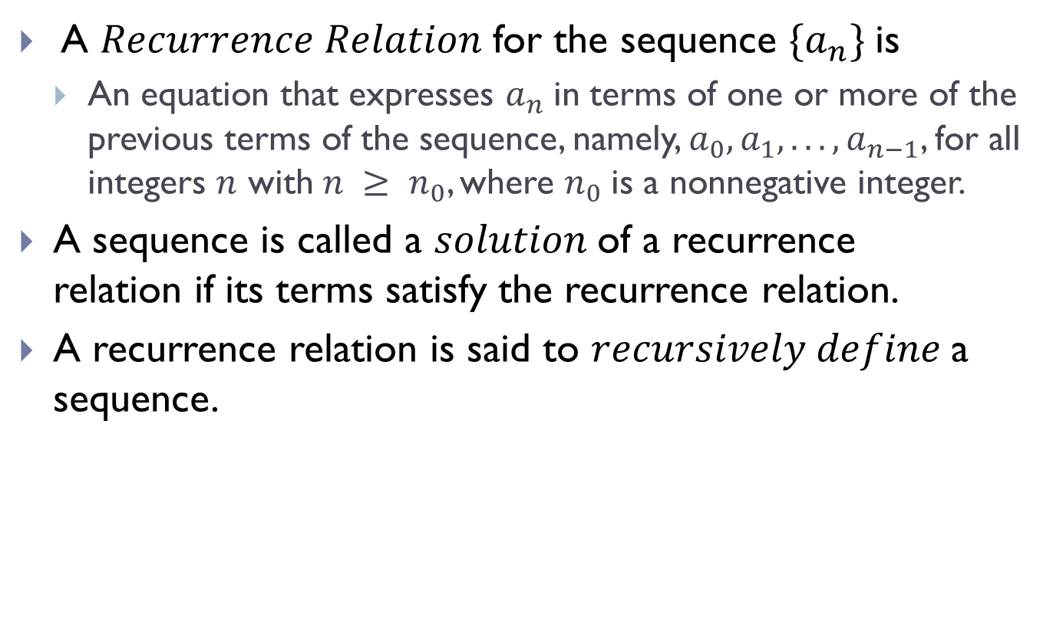
Recurrence Relations
A $Recurrence Relation$for the sequence $\{a_{n}\}$is
An equation that expresses $a_{n}$in terms of one or more of the previous terms of the sequence, namely, $a_{0}, a_{1}, . . . , a_{n−1}$, for all integers $n$ with$n ≥ n_{0}$, where $n_{0}$is a nonnegative integer.
A sequence is called a $solution$of a recurrence relation if its terms satisfy the recurrence relation.
A recurrence relation is said to $recursively define$a sequence.

Slide 10
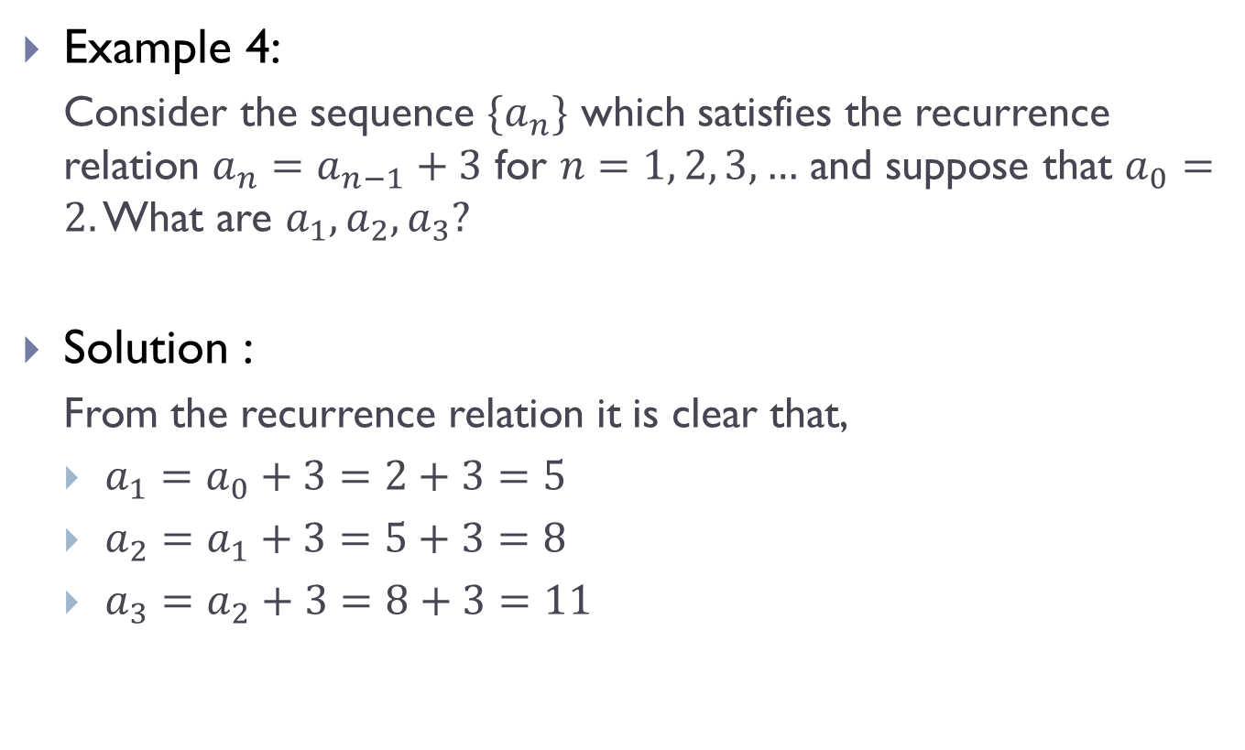
Recurrence Relations (Contd.)
Example 4:
Consider the sequence $\{a_{n}\}$ which satisfies the recurrence relation $a_{n}=a_{n−1}+3$ for $n=1, 2, 3,…$ and suppose that $a_{0}=2.$ What are $a_{1},a_{2}, a_{3}?$
Solution :
From the recurrence relation it is clear that,
$a_{1}=a_{0}+3=2+3=5$
$a_{2}=a_{1}+3=5+3=8$
$a_{3}=a_{2}+3=8+3=11$

Slide 11
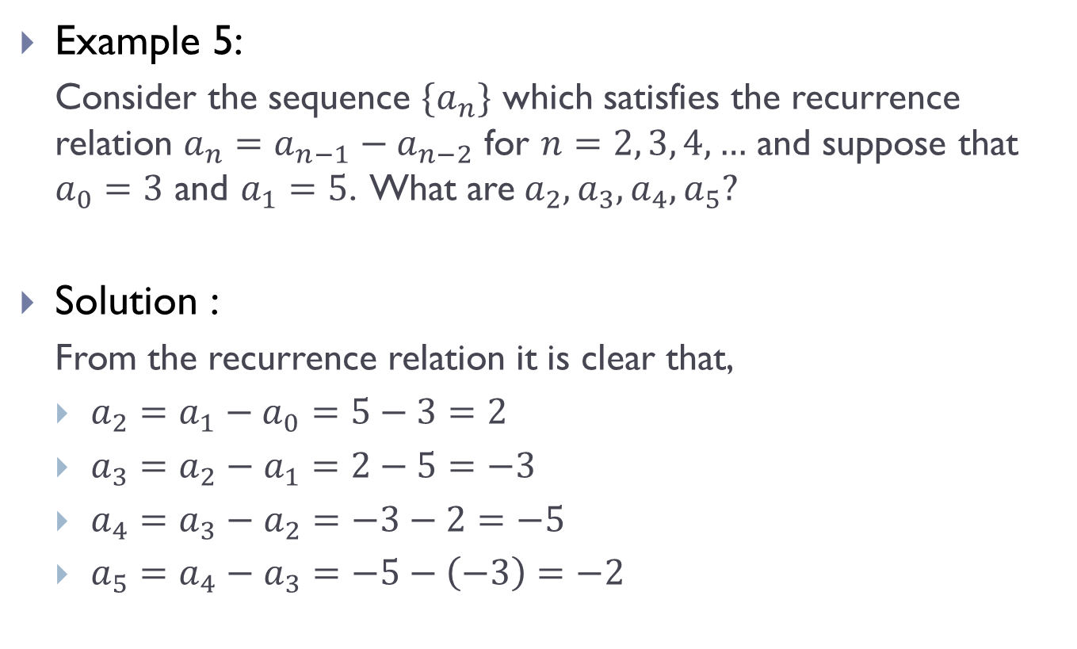
Recurrence Relations (Contd.)
Example 5:
Consider the sequence $\{a_{n}\}$ which satisfies the recurrence relation $a_{n}=a_{n−1}−a_{n−2}$ for $n=2, 3, 4, …$ and suppose that $a_{0}=3$ and $a_{1}=5$. What are$a_{2}, a_{3}, a_{4},a_{5}?$
Solution :
From the recurrence relation it is clear that,
$a_{2}=a_{1}−a_{0}=5−3=2$
$a_{3}=a_{2}−a_{1}=2−5=−3$
$a_{4}=a_{3}−a_{2}=−3−2=−5$
$a_{5}=a_{4}−a_{3}=−5−\left(−3\right)=−2$

Slide 12
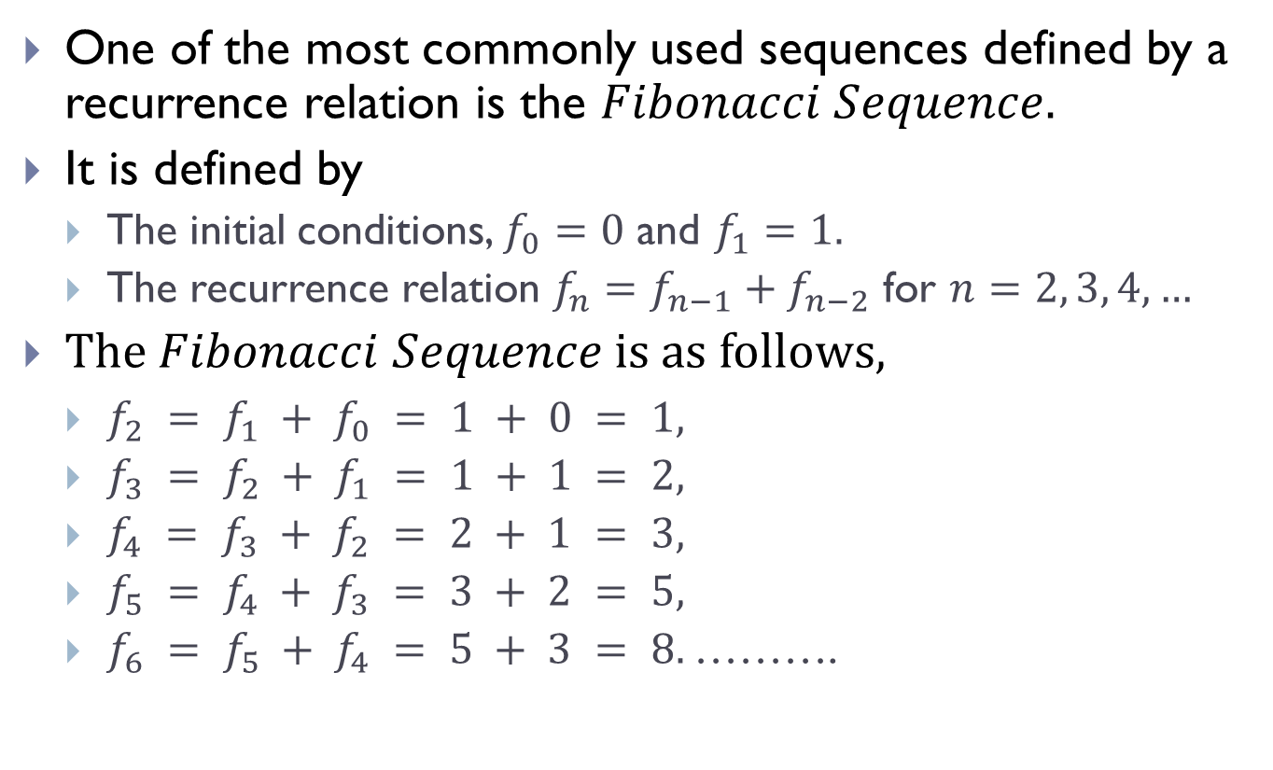
Recurrence Relations (Contd.)
One of the most commonly used sequences defined by a recurrence relation is the $Fibonacci Sequence.$
It is defined by
The initial conditions, $f_{0}=0$ and $f_{1}=1.$
The recurrence relation $f_{n}=f_{n−1}+f_{n−2}$ for $n=2, 3, 4, …$
The $Fibonacci Sequence$ is as follows,
$f_{2} = f_{1} + f_{0} = 1 + 0 = 1,$
$f_{3} = f_{2} + f_{1} = 1 + 1 = 2,$
$f_{4} = f_{3} + f_{2} = 2 + 1 = 3,$
$f_{5} = f_{4} + f_{3} = 3 + 2 = 5,$
$f_{6} = f_{5} + f_{4} = 5 + 3 = 8.$……….

Slide 13
Recurrence Relations (Contd.)
We say that we have solved the recurrence relation together with the initial conditions when we find an explicit formula, called a closed formula, for the terms of the sequence.

Slide 14
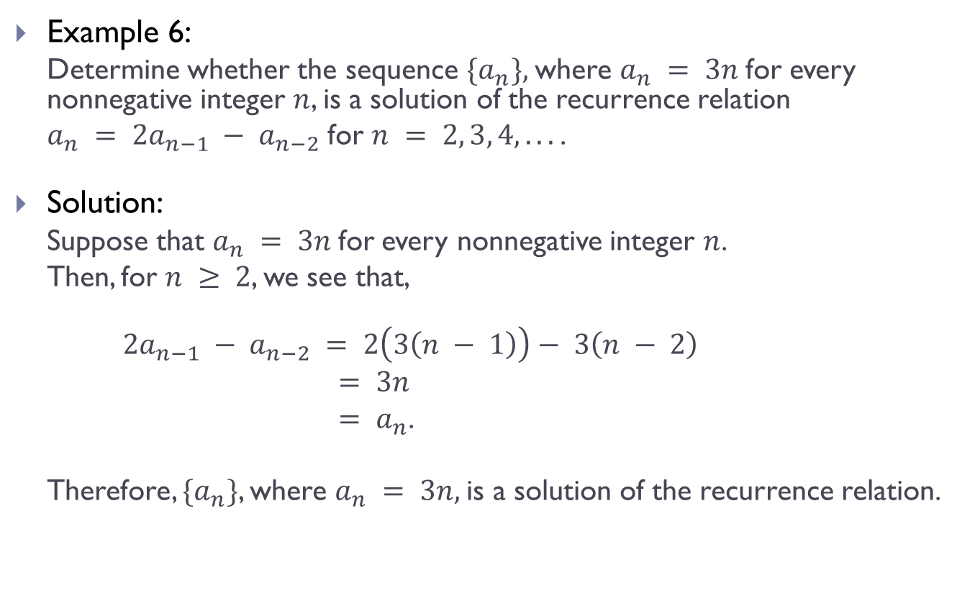
Recurrence Relations (Contd.)
Example 6:
Determine whether the sequence $\{a_{n}\},$where $a_{n} = 3n$for every nonnegative integer $n$, is a solution of the recurrence relation
$a_{n} = 2a_{n−1} − a_{n−2}$ for $n = 2, 3, 4, . . .$.
Solution:
Suppose that $a_{n} = 3n$for every nonnegative integer $n$.
Then, for $n ≥ 2$, we see that,
$2a_{n−1} − a_{n−2} = 2\left(3\left(n − 1\right)\right)− 3\left(n − 2\right)$
$= 3n$
$= a_{n}$.
Therefore, $\{a_{n}\}$, where $a_{n} = 3n,$is a solution of the recurrence relation.

Slide 15
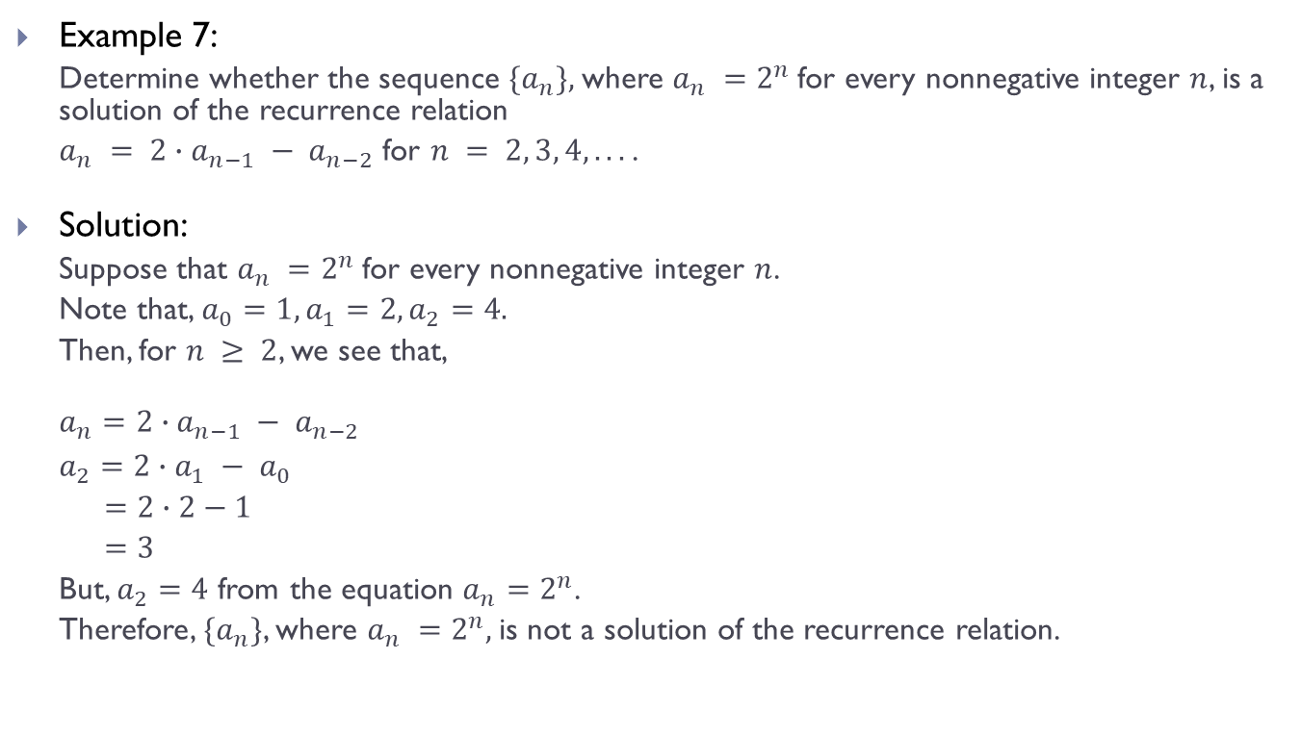
Recurrence Relations (Contd.)
Example 7:
Determine whether the sequence $\{a_{n}\},$where $a_{n} =2^{n}$for every nonnegative integer $n$, is a solution of the recurrence relation
$a_{n} = 2∙a_{n−1} − a_{n−2}$ for $n = 2, 3, 4, . . .$.
Solution:
Suppose that $a_{n} =2^{n}$for every nonnegative integer $n$.
Note that, $a_{0}=1, a_{1}=2, a_{2}=4.$
Then, for $n ≥ 2$, we see that,
${a_{n}=2∙a}_{n−1} − a_{n−2}$
${a_{2}=2∙a}_{1} − a_{0}$
$=2∙2−1$
$=3$
But, $a_{2}=4$ from the equation $a_{n}=2^{n}$.
Therefore, $\{a_{n}\}$, where $a_{n} =2^{n},$is not a solution of the recurrence relation.

Slide 16
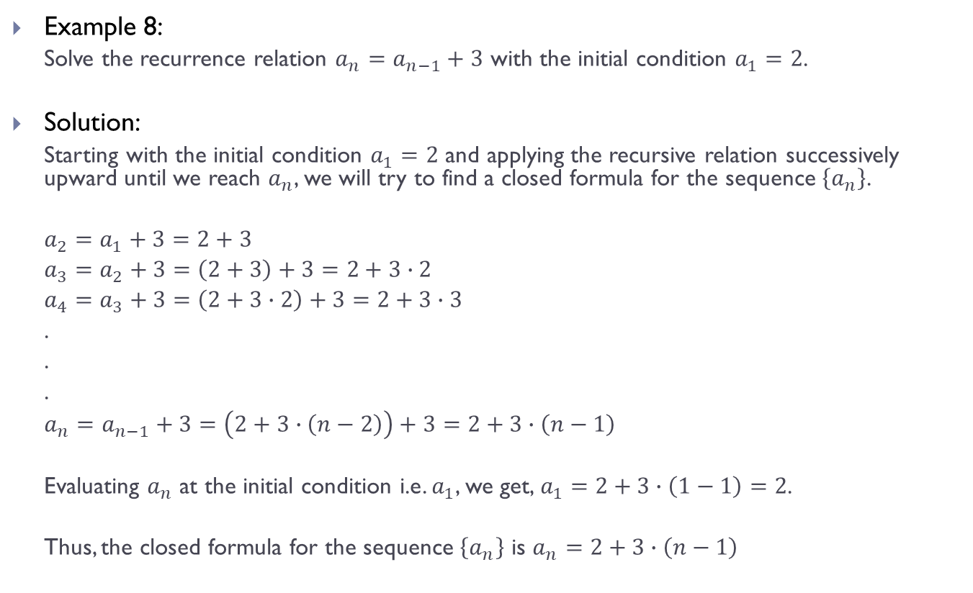
Recurrence Relations (Contd.)
Example 8:
Solve the recurrence relation $a_{n}=a_{n−1}+3$ with the initial condition $a_{1}=2$.
Solution:
Starting with the initial condition $a_{1}=2$ and applying the recursive relation successively upward until we reach $a_{n}$, we will try to find a closed formula for the sequence $\left\{a_{n}\right\}$.
$a_{2}=a_{1}+3=2+3$
$a_{3}=a_{2}+3=\left(2+3\right)+3=2+3∙2$
$a_{4}=a_{3}+3=\left(2+3∙2\right)+3=2+3∙3$
.
.
.
$a_{n}=a_{n−1}+3=\left(2+3∙\left(n−2\right)\right)+3=2+3∙\left(n−1\right)$
Evaluating $a_{n}$ at the initial condition i.e. $a_{1}$, we get,$a_{1}=2+3∙\left(1−1\right)=2$.
Thus, the closed formula for the sequence $\left\{a_{n}\right\}$ is $a_{n}=2+3∙\left(n−1\right)$

Slide 17
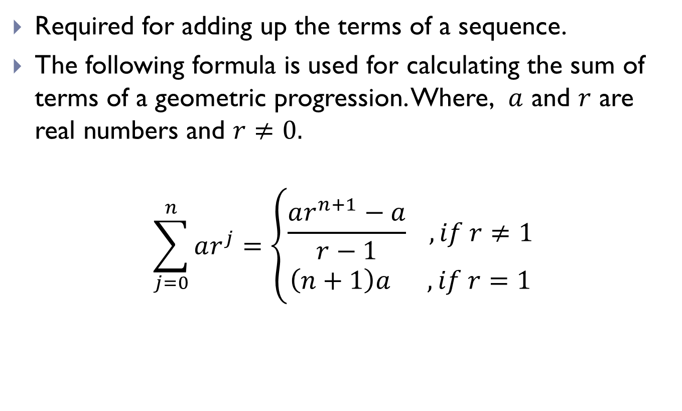
Summations
Required for adding up the terms of a sequence.
The following formula is used for calculating the sum of terms of a geometric progression. Where, $a$ and $r$ are real numbers and $r≠0.$
$$\sum_{j=0}^{n}{ar^{j}=\left\{\begin{matrix}\frac{ar^{n+1}−a}{r−1} , if r≠1 \\ \left(n+1\right)a ,if r=1\end{matrix}\right.}$$

Slide 18
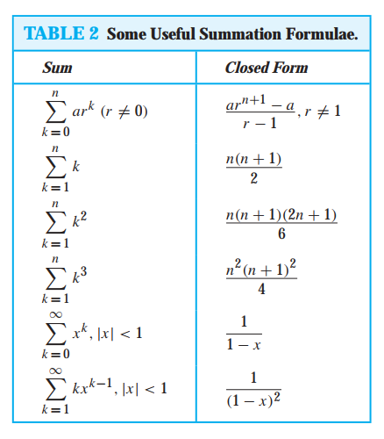
Summations (Contd.)

Slide 19
THE END

